Slide 1
Migrant
Domain
Experience
Individual
age
gender
personality
skills
knowledge
values
stereotypes
migration motive
Social
culture
religion
ethnicity
geography
interventions
economy
spirituality
home/family
health/care
legal matters/administr.
money/finances
entertainment/media
work/career/school
transport/travel
recreation/sport/art
community/politics
private/micro
internal
desire
affect
cognition
behavior
public/macro
external
Notes:
Domains = fields (bordiau)

Slide 2

Migrant
Experience
Domain
Individual
age
gender
personality
skills
knowledge
values
stereotypes
Social
culture
religion
ethnicity
geography
interventions
economy
spirituality
home/family
health/care
legal matters/administr.
money/finances
entertainment
work/career/school
transport/travel
recreation/sport/art
community/politics
internal
private/micro
desire
Heritage historical and socio-
cultural background
Host historical and socio-
cultural background
affect
cognition
behavior
external
public/macro
chrono; development
Notes:
Domains = fields (bordiau)

Slide 3
Migrant
Experience
Domain
Individual
age
gender
personality
skills
knowledge
values
stereotypes
Social
culture
religion
ethnicity
geography
interventions
economy
spirituality
home/family
health/care
legal matters/administr.
money/finances
entertainment
work/career/school
transport/travel
recreation/sport/art
community/politics
internal
private/micro
desire
Heritage historical and socio-
cultural background
Host historical and socio-
cultural background
affect
cognition
behavior
external
public/macro
chrono; development
Notes:
Domains = fields (bordiau)

Slide 4
Migrant
Experience
Domain
spirituality
home/family
health/care
legal matters/admin.
money/finances
entertainment
work/career/school
transport/travel
recreation/sport/art
community/politics
internal
private/micro
desire
Background
age
gender
personality
skills
knowledge
values
stereotypes
migration reason
Heritage historical and socio-
cultural background
Host historical and socio-
cultural background
affect
cognition
behavior
external
public/macro
Notes:
Domains = fields (bordiau)

Slide 5
Migrant
Experience
Domain
spirituality
home/family
health/care
legal matters/admin.
money/finances
entertainment
work/career/school
transport/travel
recreation/sport/art
community/politics
internal
private/micro
desire
Background
age
gender
personality
skills
knowledge
values
stereotypes
migration reason
Heritage historical and socio-
cultural background
Host historical and socio-
cultural background
affect
cognition
behavior
external
public/macro
Notes:
Domains = fields (bordiau)

Slide 6
Migrant
Experience
Domain
spirituality
home/family
health/care
legal matters/admin.
money/finances
entertainment
work/career/school
transport/travel
recreation/sport/art
community/politics
internal
private/micro
desire
Background
age
gender
personality
skills
knowledge
values
stereotypes
migration reason
Heritage historical and socio-
cultural background
Host historical and socio-
cultural background
affect
cognition
behavior
external
public/macro
Notes:
Domains = fields (bordiau)

Slide 7
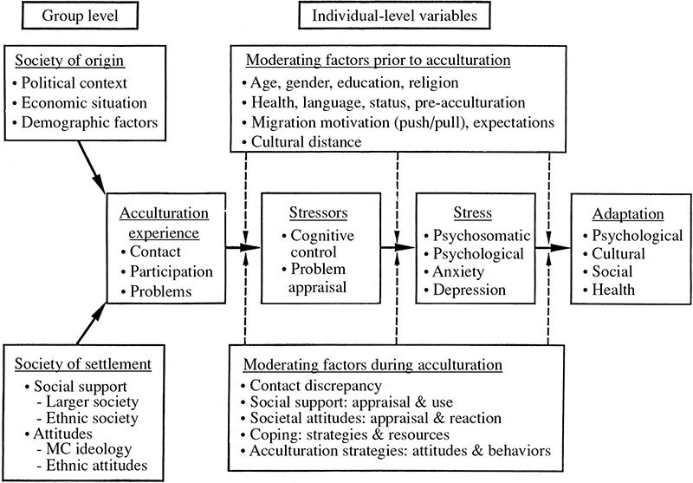

Slide 8
Acculturation Domain
Acculturation Experience
Home
Entertain.
Health
Work
Recreation
Community
Desire
Affect
Cognition
Behavior

Slide 9
Acculturation Experience
in Acculturation Domain
Desire
Affect
Cognition
Behavior
Home
Entertain.
Health
Work
Recreation
Community

Slide 10
Group level
Society of origin
Stereotypes
Knowledge
Intentions
Acculturation Experience
in Life Domain
Desire
Affect
Cognition
Behavior
Home
Entertain.
Health
Work
Recreation
Community
Society of settlement
Culture
Norms
Policies

Slide 11
Group level
Society of origin
Stereotypes
Knowledge
Intentions
Acculturation Experience
in Life Domain
Past Experiences
Desire
Affect
Cognition
Behavior
Home
Entertain.
Health
Work
Recreation
Community
Society of settlement
Culture
Norms
Policies

Slide 12
Society
Non-tangible
Tangible
Culture
Social Facts
Institutions
Situation / Domains of psycho-social functioning
informal
formal
Public
macro
Private
micro
Non-material
Material
norms, values, beliefs, rituals, customs
fashion, architecture, arts [e.g., film, music, lit., art]
law, regulations, policies, history, language
family, government, economy, media, education, healthcare, and religion
Individual

Slide 14
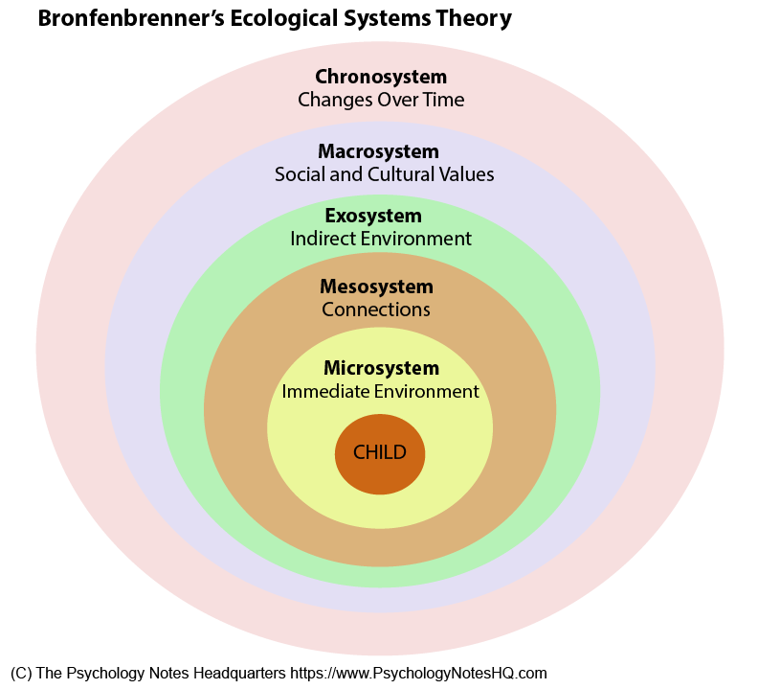

Slide 16
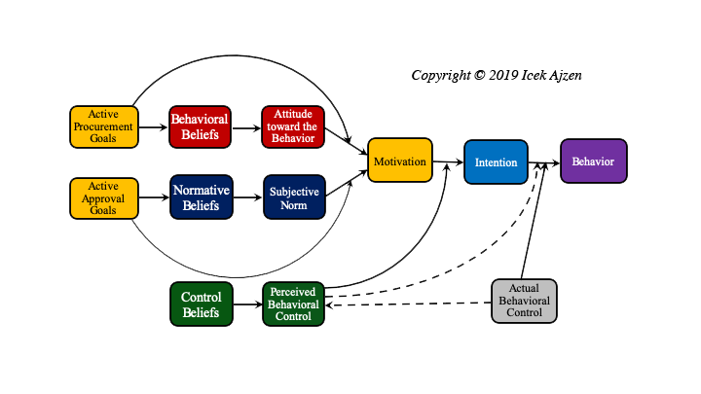

Slide 17
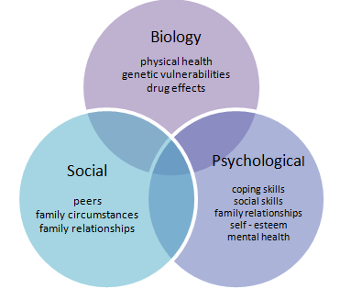

Slide 18
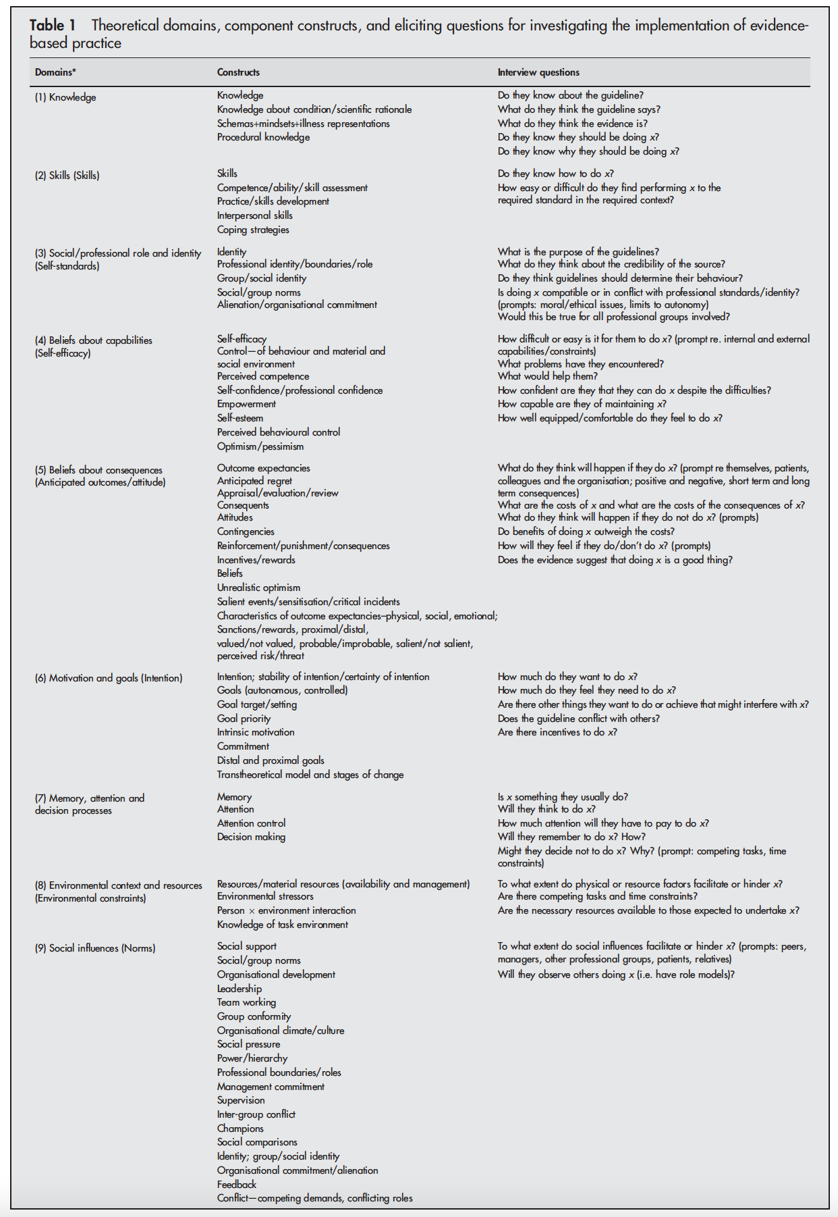
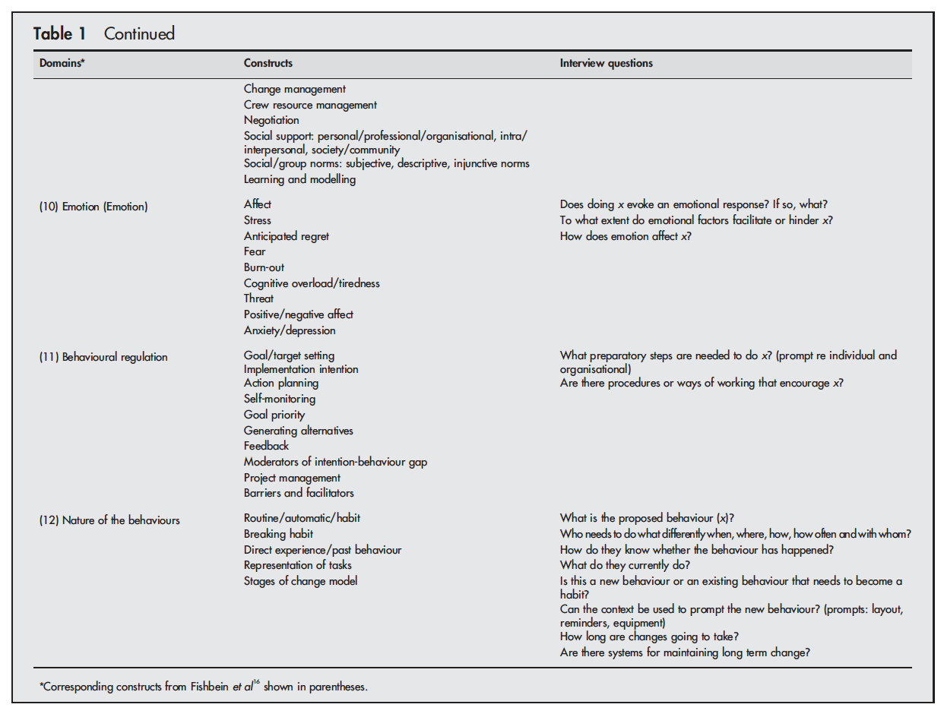
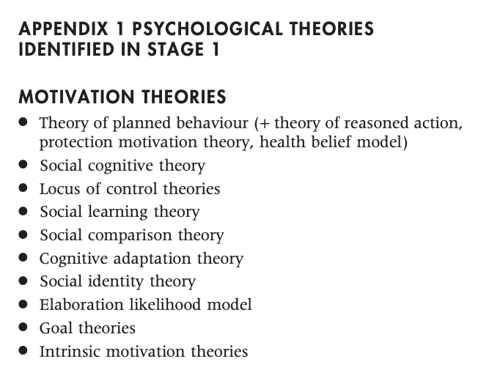
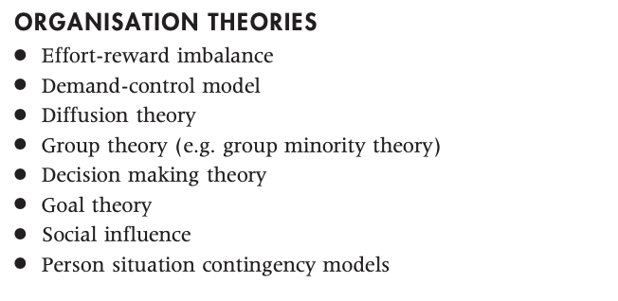
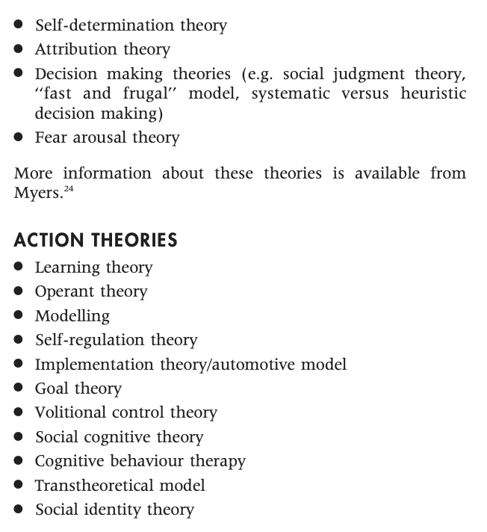
Michie, S., Johnston, M., Abraham, C., Lawton, R., Parker, D., & Walker, A. (2005). Making psychological theory useful for implementing evidence based practice: A consensus approach. Quality and Safety in Health Care, 14(1), 26–33. https://doi.org/10.1136/qshc.2004.011155

Slide 19
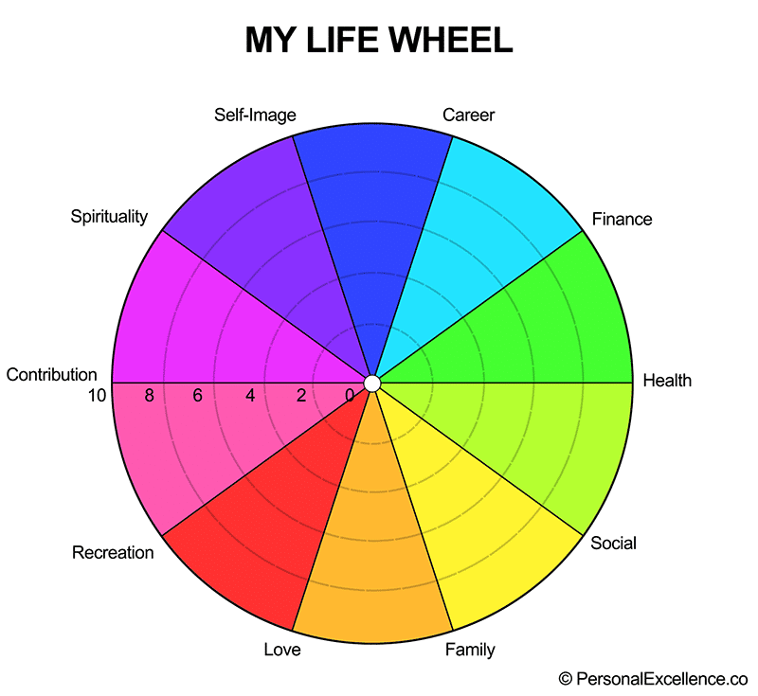

Slide 20

Migrant
Experience
Domain
Individual
age
gender
personality
skills
knowledge
values
stereotypes
Social
culture
religion
ethnicity
geography
interventions
economy
spirituality
home/family
health/care
legal matters/administr.
money/finances
entertainment
work/career/school
transport/travel
recreation/sport/art
community/politics
internal
private/micro
desire
Heritage historical and socio-
cultural background
Host historical and socio-
cultural background
affect
cognition
behavior
external
public/macro
chrono; development
Notes:
Domains = fields (bordiau)

Slide 21

Migrant
Experience
Domain
spirituality
home/family
health/care
legal matters/admin.
money/finances
entertainment
work/career/school
transport/travel
recreation/sport/art
community/politics
internal
private/micro
desire
Background
age
gender
personality
skills
knowledge
values
stereotypes
migration reason
Heritage historical and socio-
cultural background
Host historical and socio-
cultural background
affect
cognition
behavior
external
public/macro
Notes:
Domains = fields (bordiau)

Slide 22
Migrant
Experience
Domain
spirituality
home/family
health/care
legal matters/admin.
money/finances
entertainment
work/career/school
transport/travel
recreation/sport/art
community/politics
internal
private/micro
desire
Background
age
gender
personality
skills
knowledge
values
stereotypes
migration reason
Heritage historical and socio-
cultural background
Host historical and socio-
cultural background
affect
cognition
behavior
external
public/macro
Notes:
Domains = fields (bordiau)

